Slide 1
Object Oriented Programming
Lucian Iliescu
Florin Mihu

Slide 2
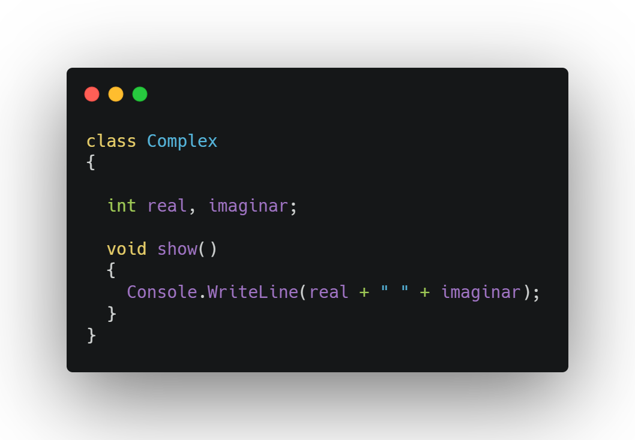
What is Object Oriented Programming?
Objects
Classes = templates
Objects = instances

Slide 3
Languages that support OOP
Java
C#
C++
Scala
Python
Ruby
Perl

Slide 4
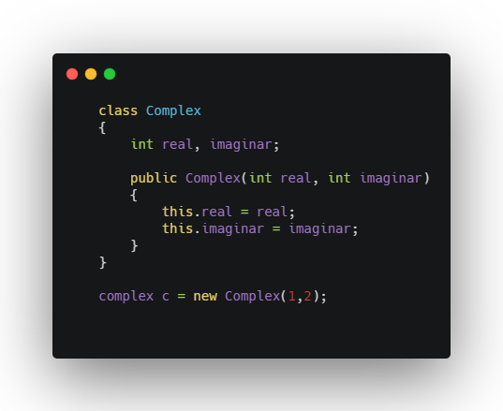
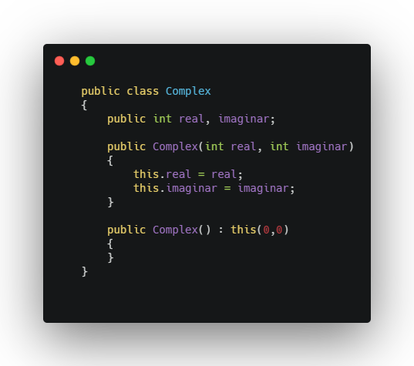
Constructors
Create instances
“this” differences the parameters with the same name as class fields
“this” calling constructor from another constructor

Slide 5
Object Oriented Programming principles
Inheritance
Encapsulation
Polymorphism
Abstractization

Slide 6
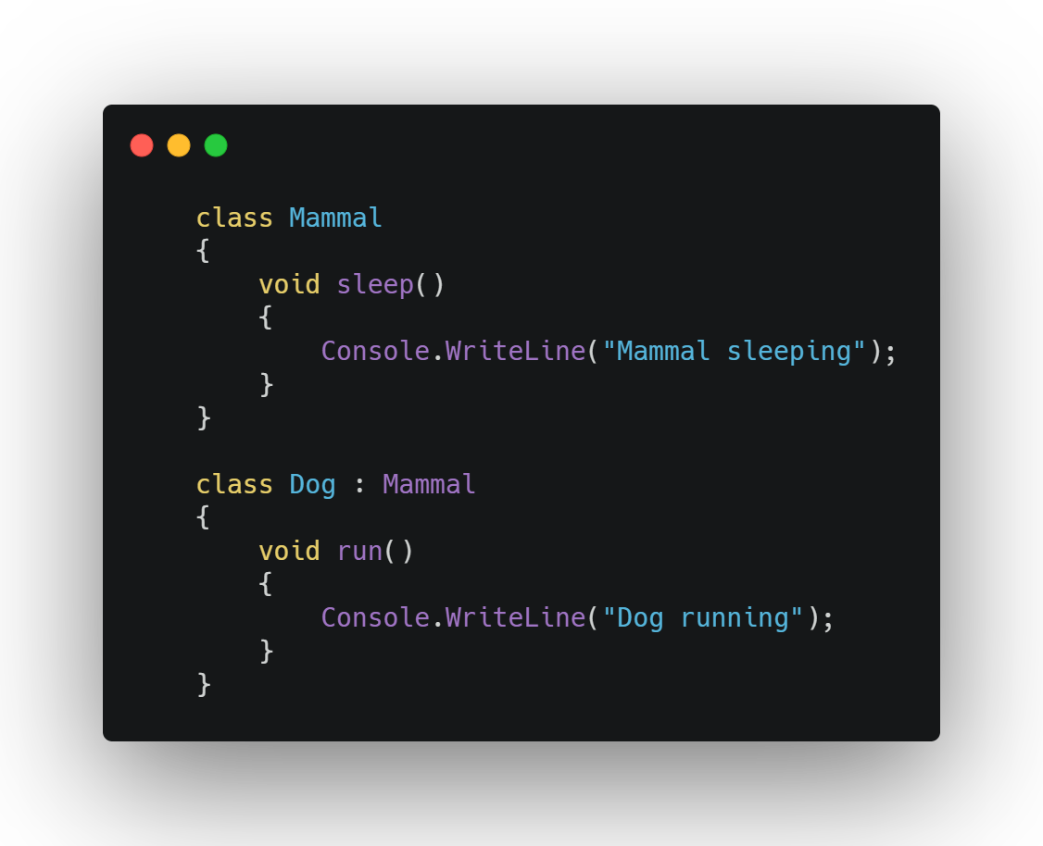
Inheritance
A class (sub-class) extends another class (super-class)
Super-class = parent class
Sub-class = child class

Slide 7
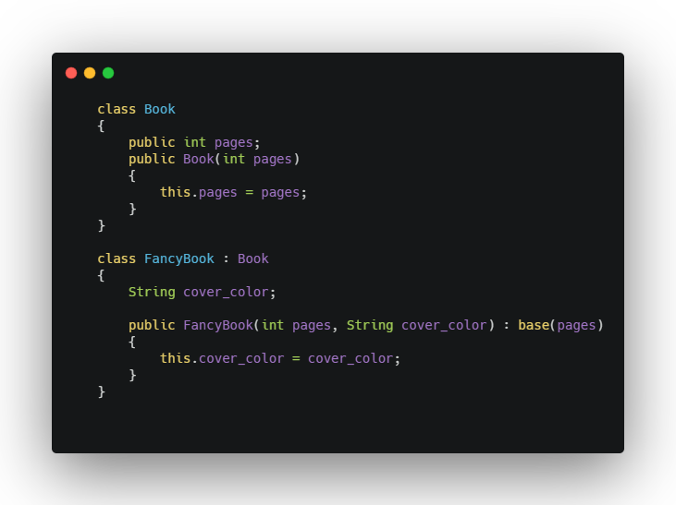
Inheritance
“base” is used to call a method from the parent class or to call the parent constructor inside the constructor

Slide 8
Encapsulation
Data hiding using access modifiers
public
private
protected

Slide 9
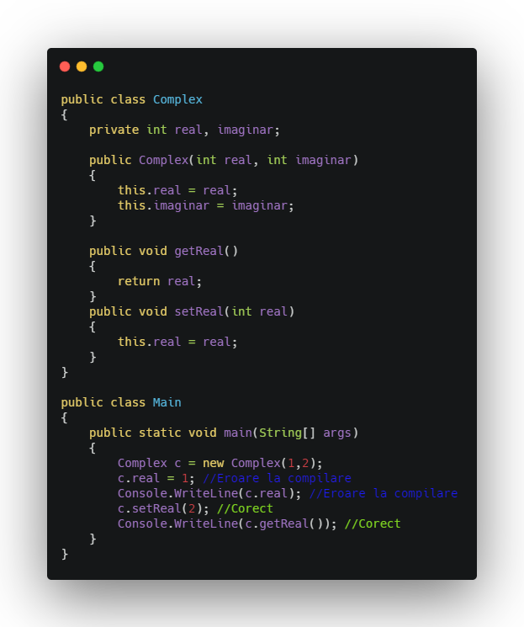
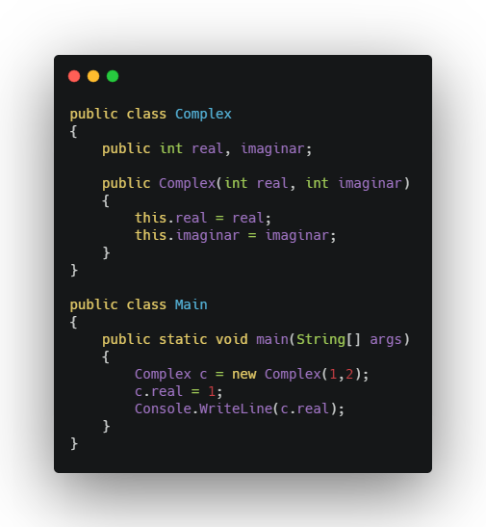
Encapsulation

Slide 10
Polymorphism
Dynamic and static
Static takes place at compile time
Dynamic takes place at run time

Slide 11
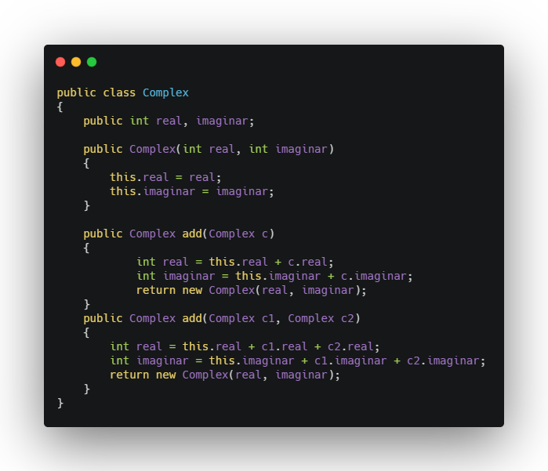
Static polymorphism
Method overloading = multiple methods have the same name but different parameters

Slide 12
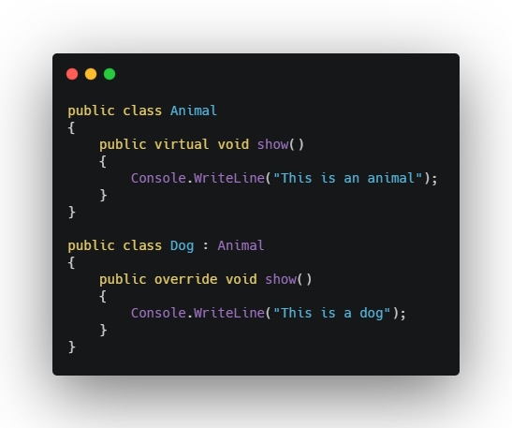
Dynamic polymorphism
Method overriding = replacing the functionality of a method in parent class

Slide 13
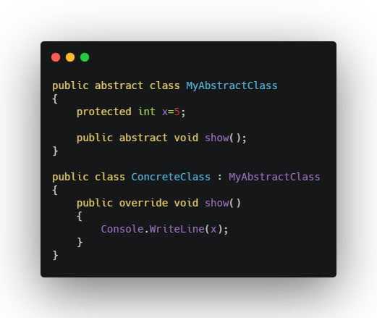
Abstractization (Abstract classes)
Abstract method = only it’s signature is declared
Abstract classes can’t be instantiazed
They can have abstract and concrete methods

Slide 14
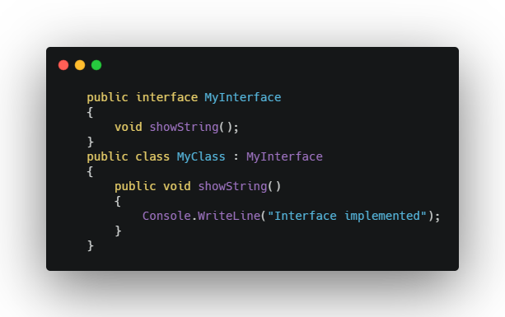
Abstractization (Interfaces)
Contains only abstract methods and constants
A class has to implement all the methods of the interface
A class can implement any number of interfaces

Slide 15
Demo

Slide 16
THE END

